Slide 1
Support Vector Regressor
Linear/Non-Linear, Parametric, Multivariate Regressor

Slide 2
Support Vector Regression
The method of Support Vector Classification can be extended to solve regression problems. This method is called Support Vector Regression.
In case of Support Vector Classification, the model produced by support vector depends only on a subset of the training data, because the cost function for building the model does not care about training points that lie beyond the margin.
Analogously, the model produced by Support Vector Regression depends only on a subset of the training data, because the cost function for building the model ignores any training data close to the model prediction.

Slide 3
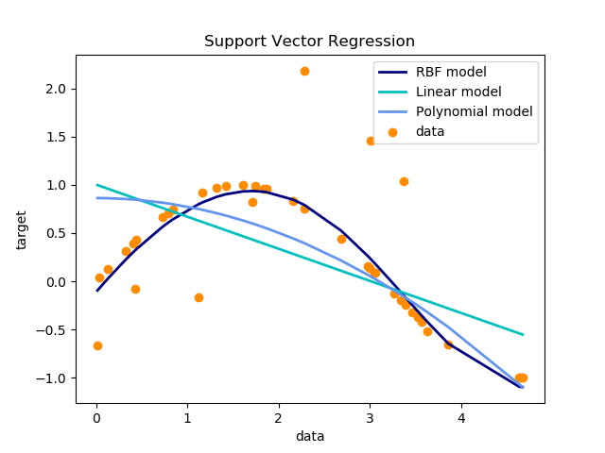


Support Vector Regressors (SVR) support Linear Regression and Non- Linear Regression.

Slide 4
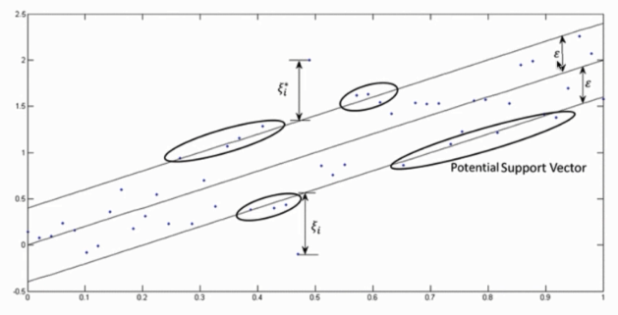


SVR tries to fit as many instances as possible on the street while limiting margin violations. The width of the street is controlled by a hyper-parameter Epsilon.

Slide 5

Support Vector Regression (SVR) models have a different goal compared to a Linear Regression models. In Linear Regression models, we try to minimize the error between the prediction and the real data. In SVR models, our goal is to ensure that the errors do not exceed the threshold.

Slide 6
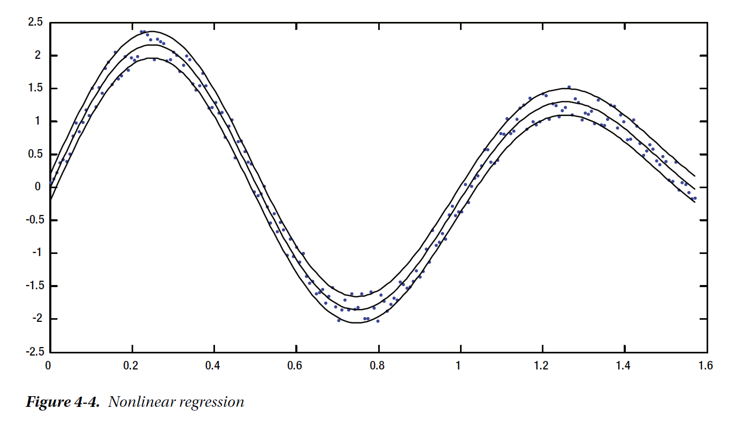


Slide 7


Steps to build a SVR
Collect the training set
Choose a kernel and its parameters & regularization (if needed)
Form the correlation matrix
Train the machine (exactly or approximately) to get contraction coefficients
Use those coefficients to create the Estimator/Regressor.

